Slide 1
Java
Latest Features
https://docs.oracle.com/javase/tutorial/index.html

Slide 2
OOPS
https://www.geeksforgeeks.org/object-oriented-programming-oops-concept-in-java/
https://www.javatpoint.com/java-oops-concepts
https://docs.oracle.com/javase/8/docs/api/
Design Pattern
https://www.javatpoint.com

Slide 3
Collection
https://docs.oracle.com/javase/tutorial/collections/intro/index.htm
https://docs.oracle.com/javase/tutorial/collections/index.html
https://www.javatpoint.com/collections-in-java
Arays
https://docs.oracle.com/javase/tutorial/java/nutsandbolts/arrays.html
Disadvantage of arrays
https://www.dummies.com/programming/java/programming-java-the-limitations-of-arrays/
Fixed in size
Arrays can hold homogenous data only
No undelaying methods support to iterate, add, or remove or manipulate data
ArraysVs Collection
https://www.tutorialspoint.com/difference-between-arrays-and-collection-in-java
Notes:
int x= 10
Int y = 11
Int z=12
Student
Student student=new Student()
We are storing individual 3 variable to represent 3 values
What do if we to declare 10000 values arrays
Employee [] emp=new Employee[10000]
So readability of the code is increased
Huge number of values can be stored
Fixed in size
Arrays can hold homogenous data only
Employee [] emp=new Employee[10000]
Emp[0]=new Employee();
Emp[1]=new Owner();
Throws incompatible type Object
To make Heterogenous
Object [] obj=new Object[10000]
Obj[0]=New Employee();
Obj[1]=New Owner

Slide 4
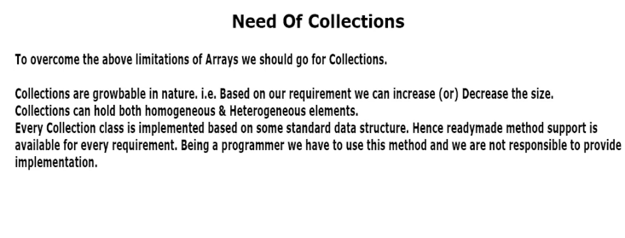

Slide 5
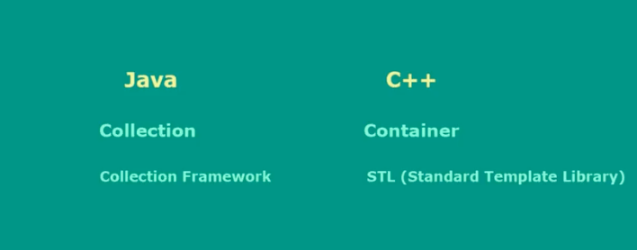

Slide 6
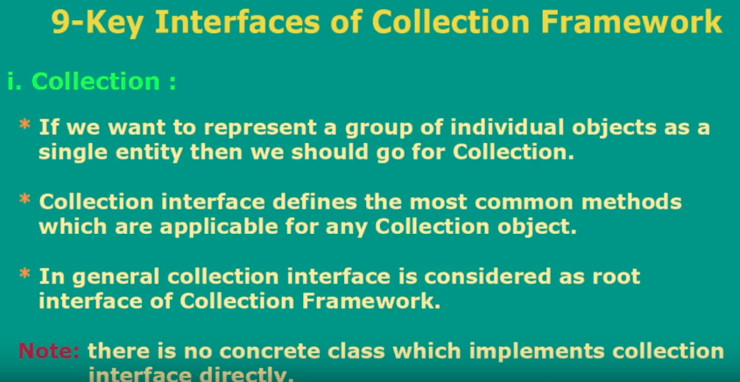
Collections Interfaces
https://docs.oracle.com/javase/tutorial/collections/interfaces/index.html
https://docs.oracle.com/javase/8/docs/api/index.html?java/util/Collection.html

Slide 7
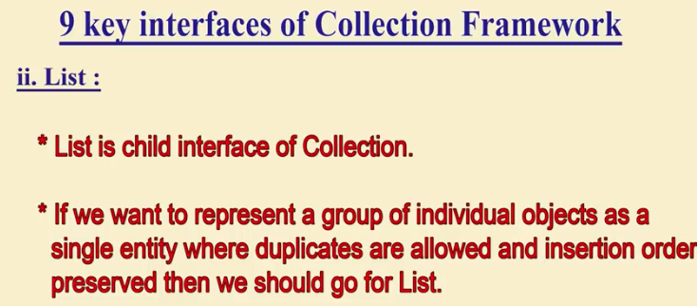
List Interface
https://docs.oracle.com/javase/7/docs/api/index.html?java/util/List.html

Slide 8
https://docs.oracle.com/javase/tutorial/index.html

Slide 12
Annotation
http://tutorials.jenkov.com/java/annotations.html
https://www.geeksforgeeks.org/annotations-in-java/
https://docs.oracle.com/javase/tutorial/java/annotations/

Slide 13
Lambda Expression
https://www.javatpoint.com/java-lambda-expressions
https://www.geeksforgeeks.org/lambda-expressions-java-8/

Slide 14
Generics
https://www.javatpoint.com/generics-in-java

Slide 15
IO
https://www.javatpoint.com/java-bufferedinputstream-class

Slide 16
Thread
https://www.javatpoint.com/creating-thread

Slide 17
Exception Handling
https://www.javatpoint.com/exception-handling-in-java

Slide 18
Regex
https://www.javatpoint.com/java-regex

Slide 25
Student Module
Student
Institution
PersistanceServiceLayer
Course
Enrollment
Financial
Notes:
Object should be highly Cohesive
Object should be loosely Coupled

Slide 26
OrgModule
Institution
PersistanceServiceLayer
Employee
Course
Enrollment
Financial
Admin
Notes:
Object should be highly Cohesive
Object should be loosely Coupled

Slide 28
New Feature
https://www.javatpoint.com/New-features-in-java

